Slide 1

Lecture 09
Fundamental Laptops and Portable Devices
CT4005NI - Computer Hardware and Software Architectures

Slide 2

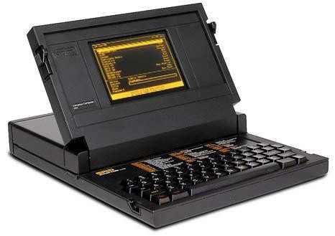
Introduction
First laptops were developed in early 1980.
GRiD Compass 1101.
5Kg with a price of $10,000.
Laptops and PDAs and Smartphones are getting
popular
Objectives
Describe laptops and other portable devices.
Identify and describe the components of a laptop.
Compare and contrast desktop and laptop components.
Explain power management in laptop.

Slide 3
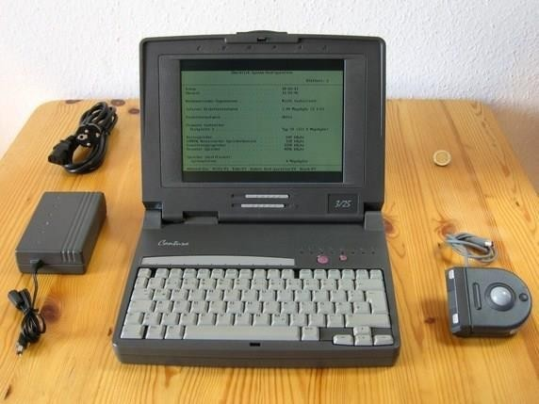
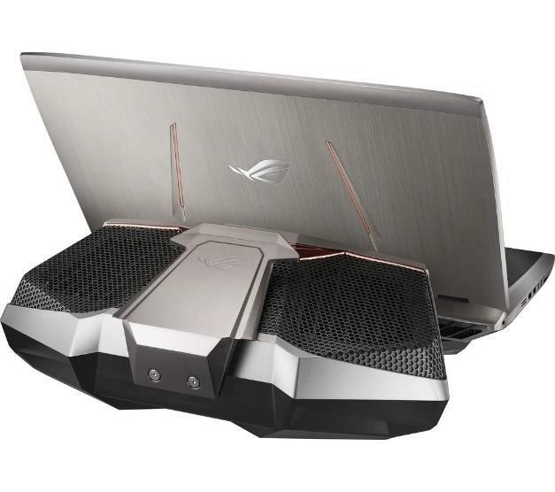
Laptops and Other Portable Devices
Earlier ones were heavy and expensive.
GRiD featured an Intel 8086 (8MHz) processor, 256KB RAM, a 6-Inch 320 x 240 monochrome display.
GRiD featured Serial and Parallel ports for I/O.
HDD and FDD had to be connected via IEEE-488.
With advancement in technology, laptops are slim, powerful with improved capabilities.
ASUS ROG GX700VO has an Intel Core i7 6820HK processor, upto 64GB of DDR4 RAM, Nvidia GTX 980 graphics processor with 8GB GDDR5 memory. A 1920 x 1080 or a 4K G-Sync display.
Components cooled using water cooling.

Slide 4
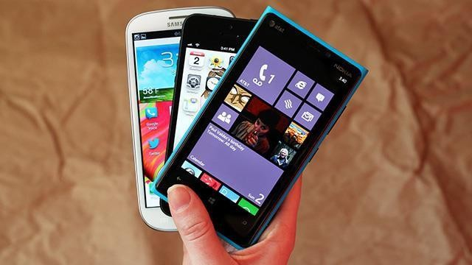
Other Portable Devices
PDAs and Smartphones are becoming more popular.
They offer customers the same features which desktop or laptops provide.
They run on powerful kernals which resides in an operating system which makes them efficient at processing information.

Slide 5
Identify Common Uses of Laptops
Taking notes in school or researching papers
Presenting information in business meetings
Accessing data away from home or the office
Playing games while traveling
Watching movies while traveling
Accessing the Internet in a public place
Sending and receiving e-mail in a public place

Slide 6
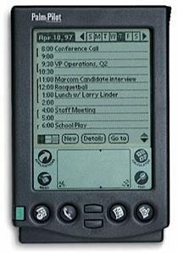
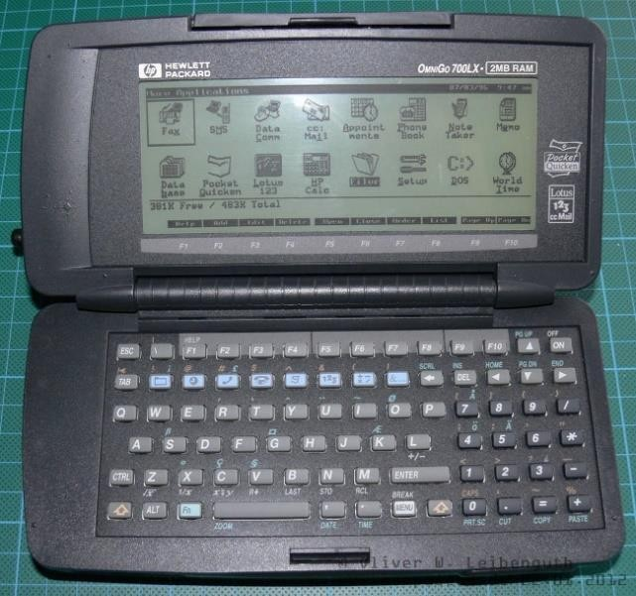
Identify Common Uses of PDAs
Concept of PDA has existed since 1970s.
Earliest models were designed to have a touch screen or a keyboard.
The PDA is an electronic personal organizer with tools to help organize information:
Address book
Calculator
Alarm clock
Internet access
E-mail
Global positioning

Slide 7

Identify Common Uses of Smartphones
The smartphone is a mobile phone with PDA capabilities.
Smartphones combine cell phone and computer functions in a
single, handheld device.
Smartphones may include these additional options:
Built-in camera
Document access
E-mail
Abbreviated note-taking
Television and Gaming capabilities

Slide 8
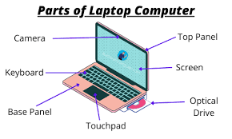
Identify the Components of a Laptop
Components found on the Outside of laptops:
Microphone
Camera
Display Panel
Power Button
Keyboard (Numeric Key pad)
Touchpad
Status Indicators
Battery Bay (Battery pack and Battery lock)
Air Vents
RAM and HDD Compartments
Speakers
AC Power connector port

Slide 9
Identify the Components of a Laptop Cont.
Components found on the Outside of laptops:
Headphone output jack port
Microphone input jack port
USB 2.0 or 3.0 ports
Mini Display ports and Thunderbolt port
HDMI Port
LAN Port
VGA Port
Security Slot
Optical Drive (Drive indicator, eject button and Manual Eject hole)
Memory Card Reader

Slide 10
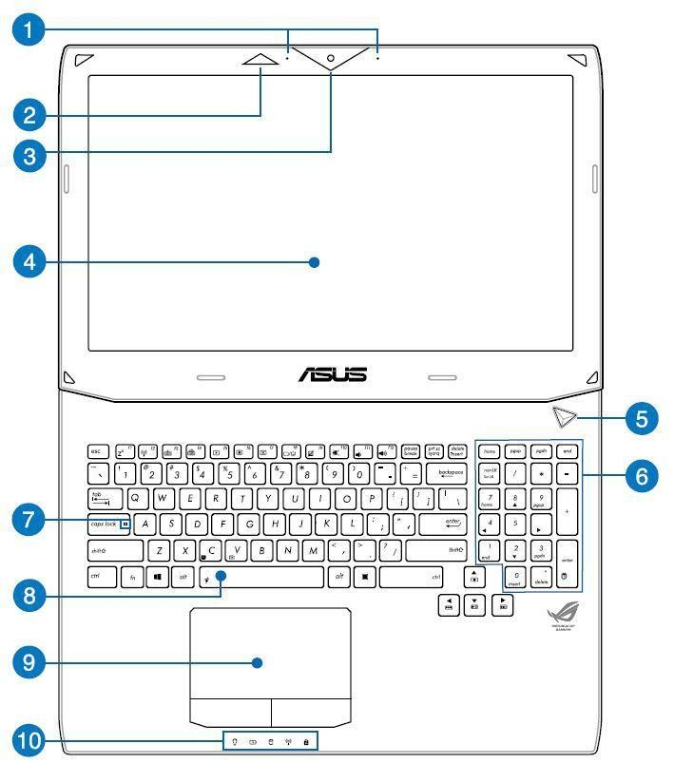
Identify the Components of a Laptop Cont.

Slide 11
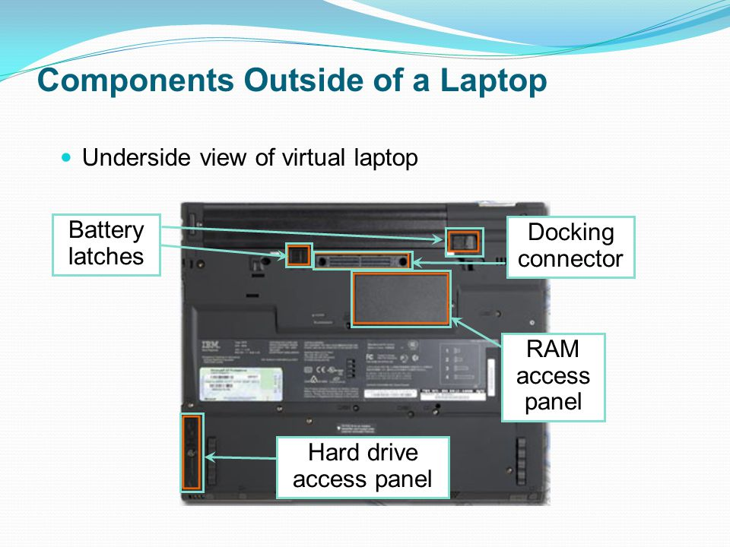
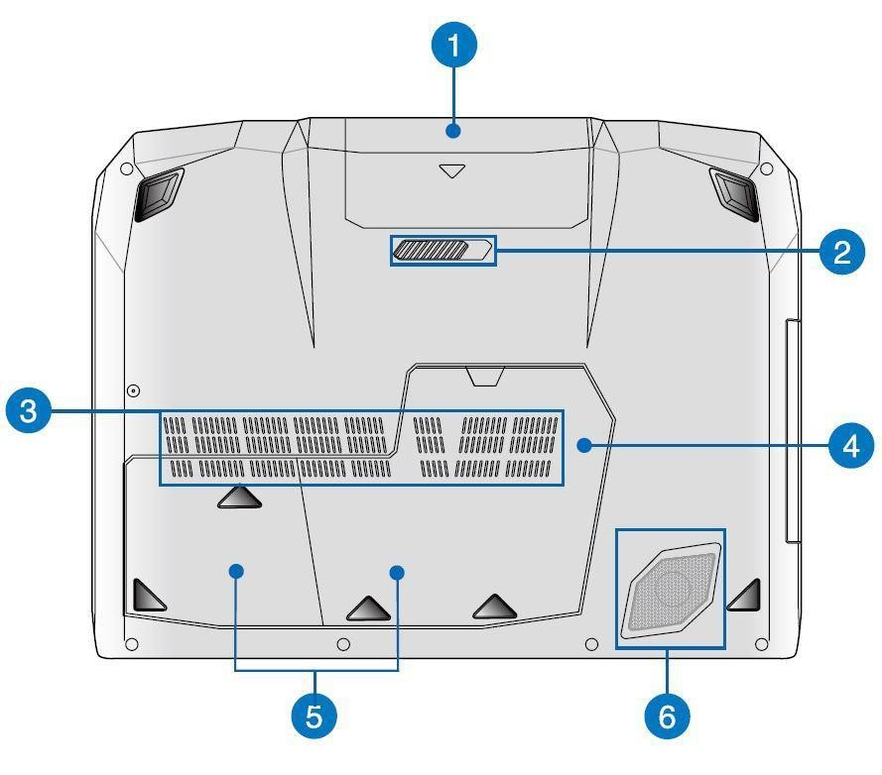
Identify the Components of a Laptop Cont.

Slide 12
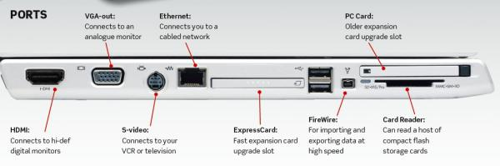
Identify the Components of a Laptop Cont.

Slide 13
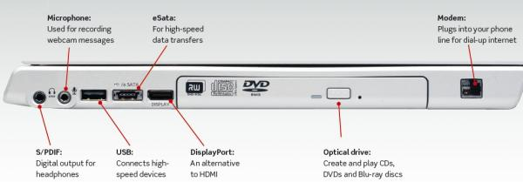
Identify the Components of a Laptop Cont.

Slide 14
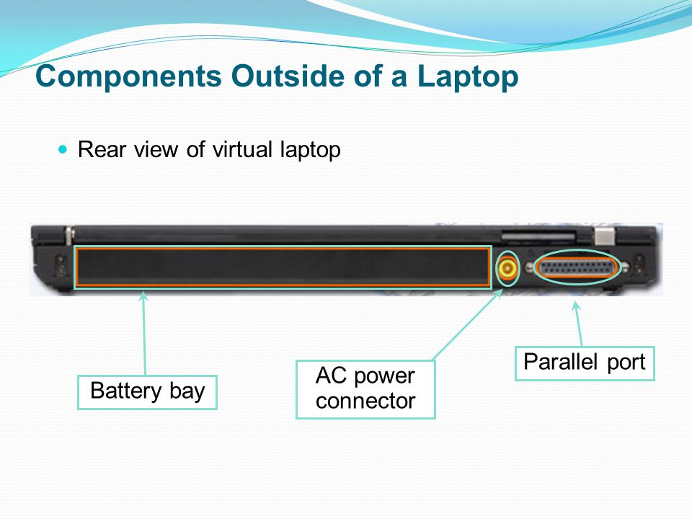

Slide 15
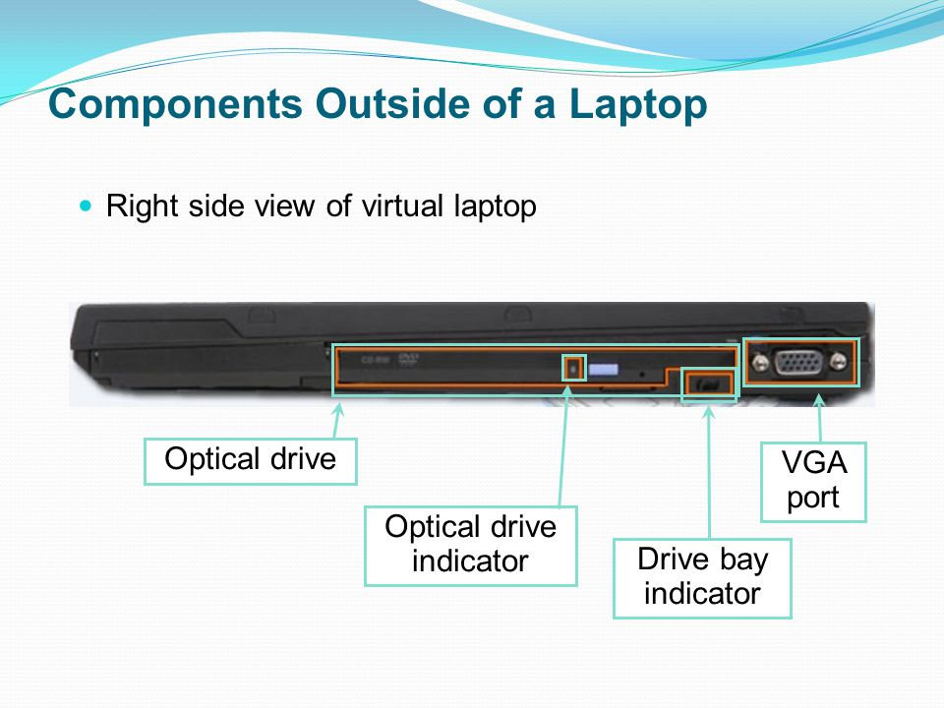

Slide 16
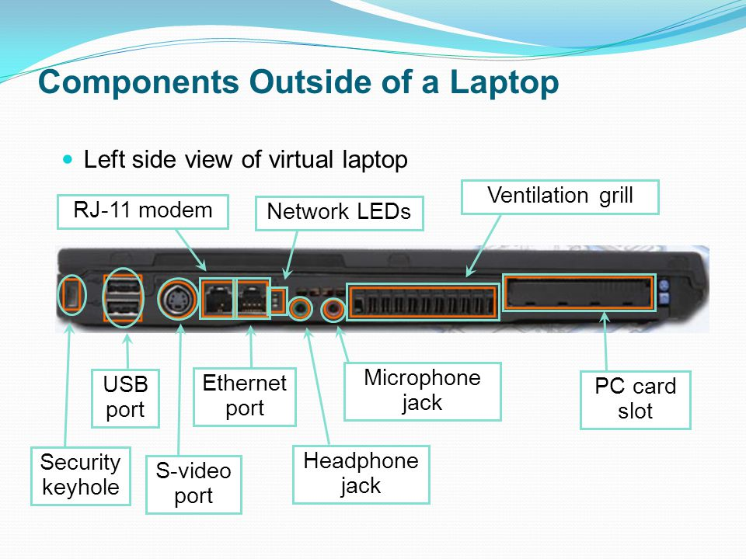

Slide 17
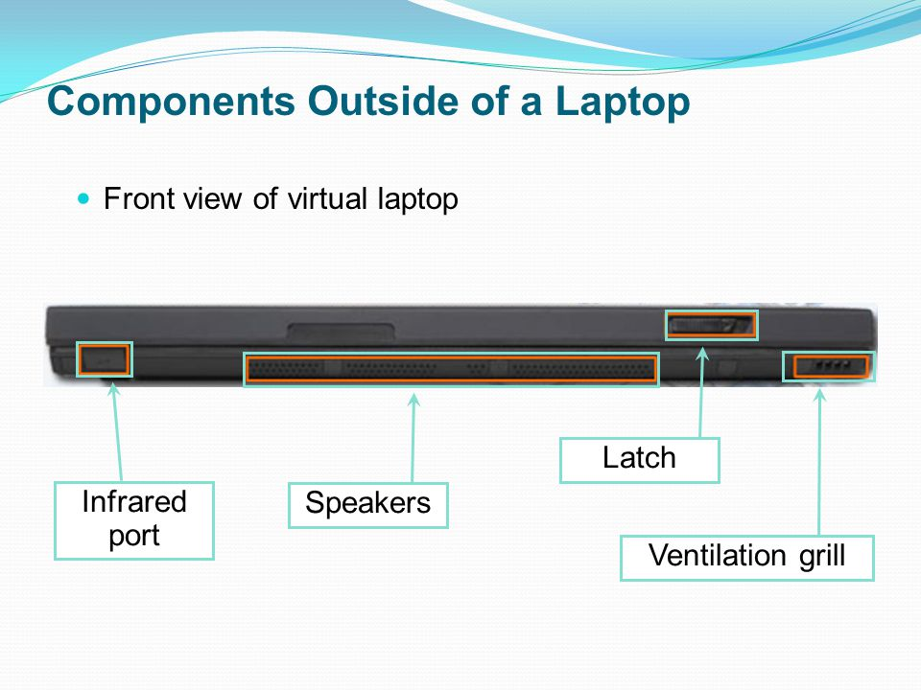

Slide 18
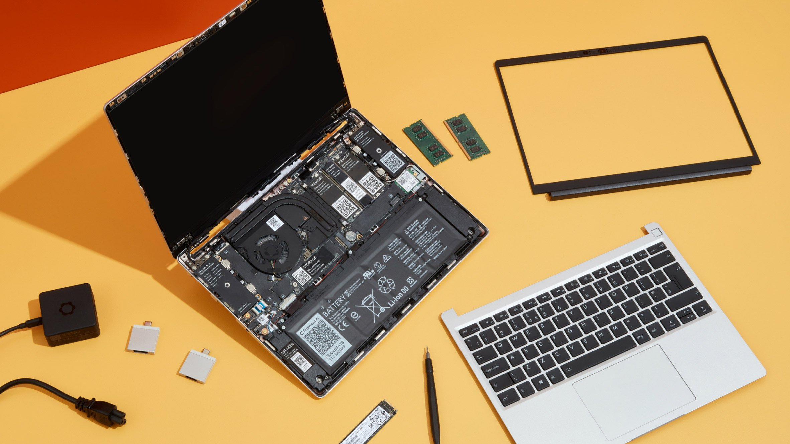

Slide 19
Compare and Contrast Desktop and Laptop Components
Desktop Motherboards have standard form factors.
This standard shape and size allows motherboards from various manufacturers to be interchangeable.
However, Motherboards in Laptops vary by manufacturer and are proprietary.
This lack of standardization in Laptops makes it impossible to swap motherboards between different manufacturers.
Computer components designed for a Desktop motherboard cannot be used in a motherboard which is designed for Laptops.

Slide 20
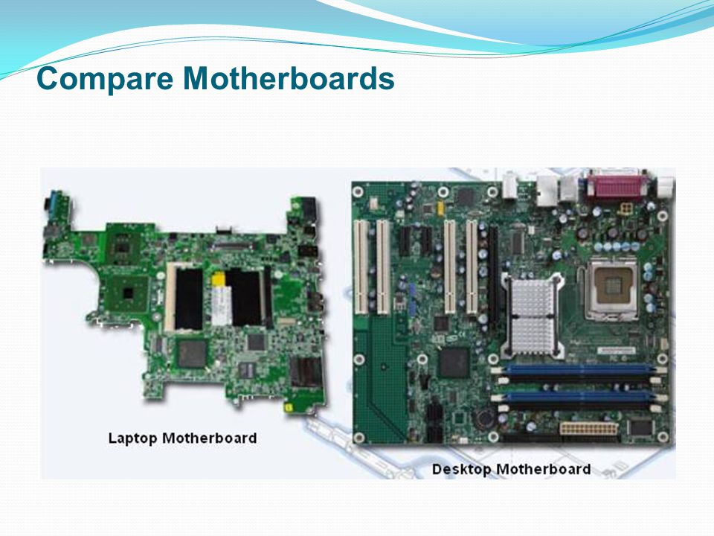

Slide 21
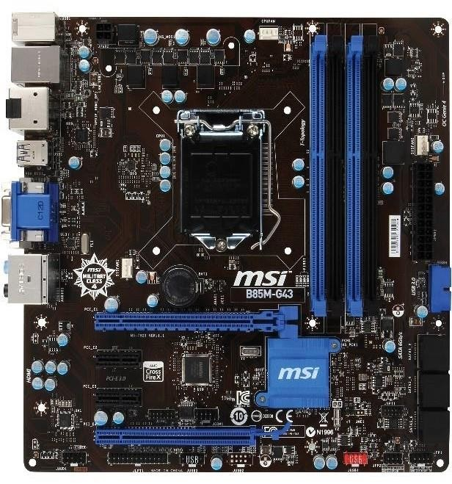
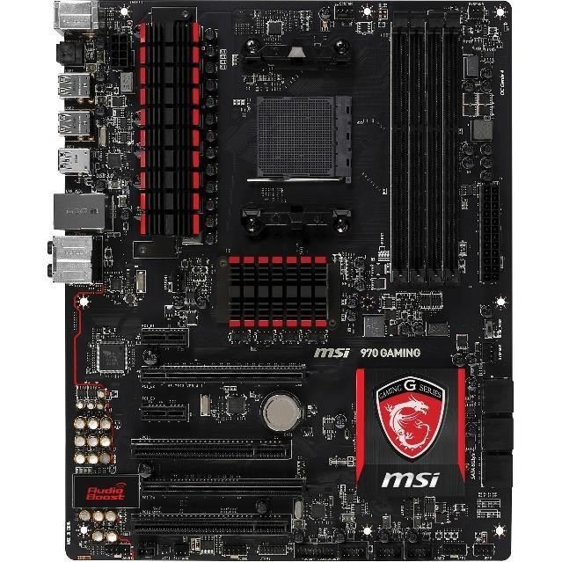
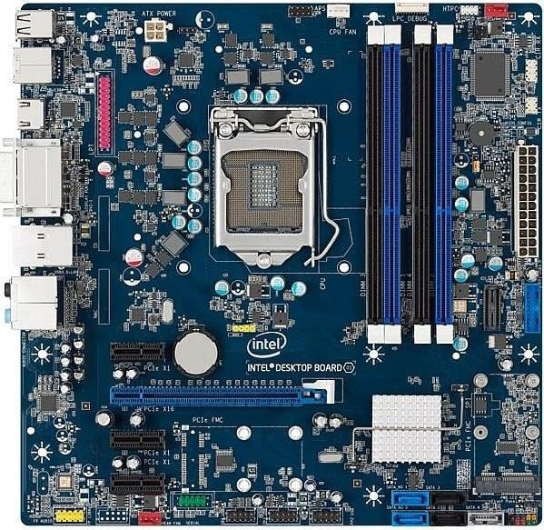
Compare and Contrast Desktop and Laptop Components
Desktop Motherboards

Slide 22
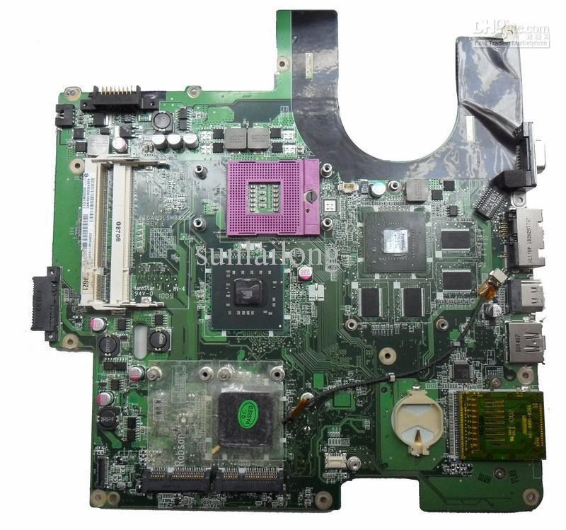
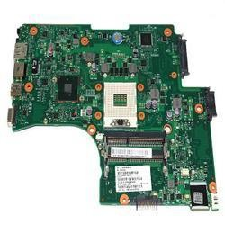
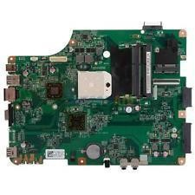
Compare and Contrast Desktop and Laptop Components
Laptop Motherboards

Slide 23
Compare and Contrast Desktop and Laptop Components
CPU is the brain of the computer, which implies that it is one of the most fundamental component of out computer system.
CPU processes instructions that are used to manipulate data.
The processors used in Laptops are designed to use less power which in turn creates less heat than the desktop processors.
CPU is throttled to modify the clock speed as needed to reduce the power consumption and heat.
Performance thus take a slight dip in processors used in Laptops.
Newer CPUs for both Laptops and Desktops tend to have increased number of cores with an Integrated
Graphics core built in.
CPUs are generally soldered on motherboards in Laptops which eliminates the possibility of future upgrade.

Slide 24
Compare and Contrast Desktop and Laptop Components
Expansion capabilities adds functionality to a computer system.
Modems, network cards, wireless adapters, external drives and other peripherals can be used with Laptops as well.
USB, Firewire and other such ports can be used to connect a range of external components to a Laptop like printers and scanners, keyboard and mouse, flash drives and optical drives, etc.
The difference of form factor between a Desktop and Laptop requires a different set of internal expansion slots to be used.
Thus, Laptops generally use: SODIMM slot for RAM, mini PCIe or expandability, 2.5’ drive bays or M.2 SSD for storage options.
Older expandability techniques were to use PCMCIA or PC Cards.
Newer expandability technique used is using Express Cards.

Slide 25
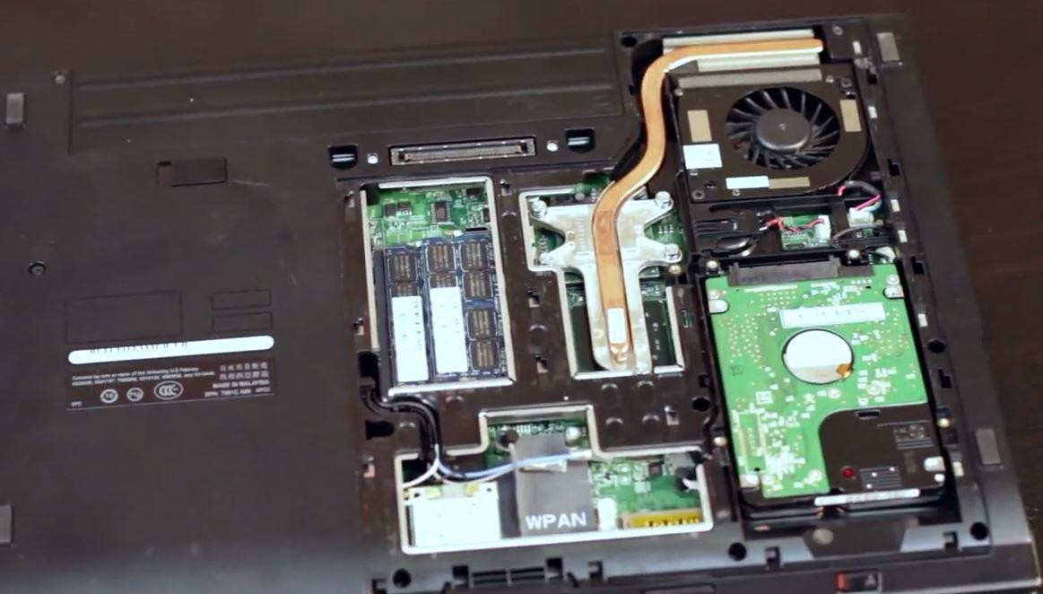
Compare and Contrast Desktop and Laptop Components
Expansion Slots in a Laptop

Slide 26
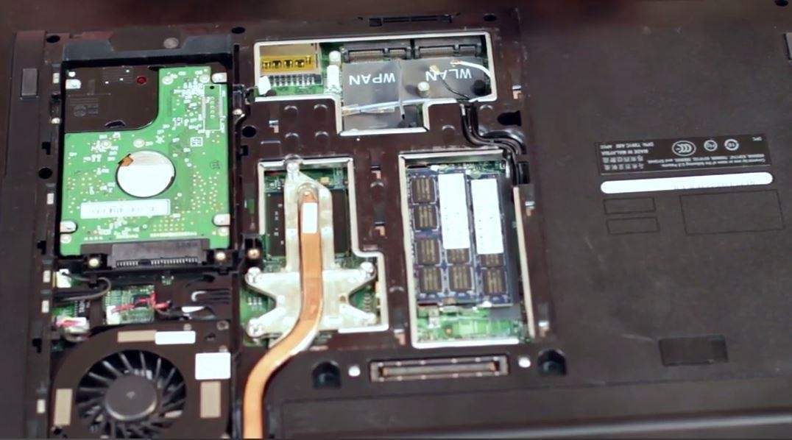
Compare and Contrast Desktop and Laptop Components
Expansion Slots in a Laptop

Slide 27
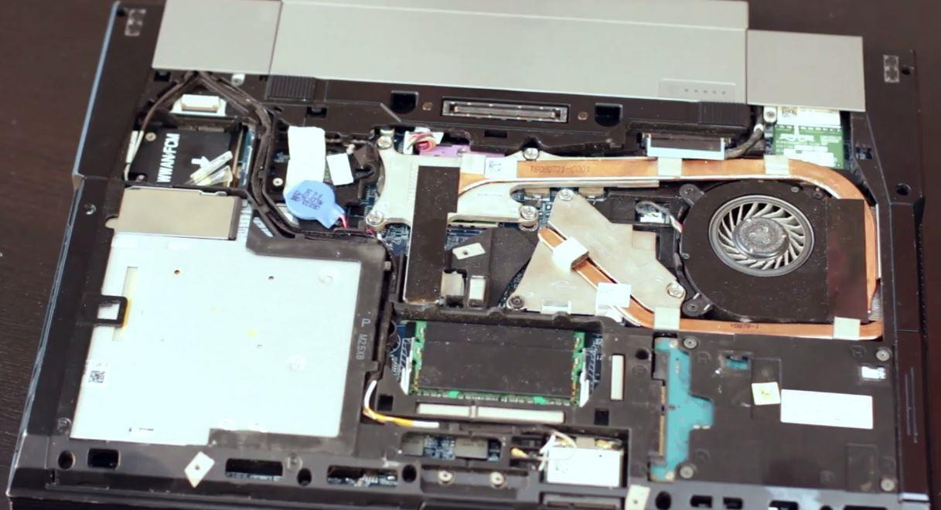
Compare and Contrast Desktop and Laptop Components
Expansion Slots in a Laptop

Slide 28
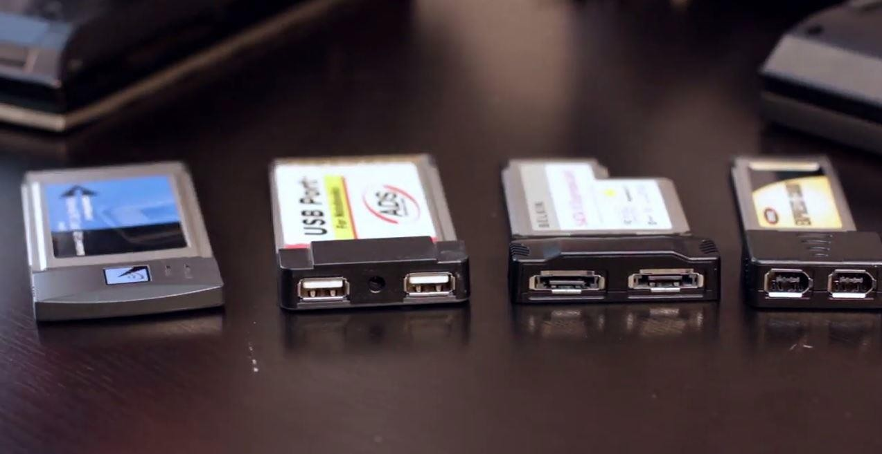
Compare and Contrast Desktop and Laptop Components
PCMCIA, PC Cards and Express cards

Slide 29
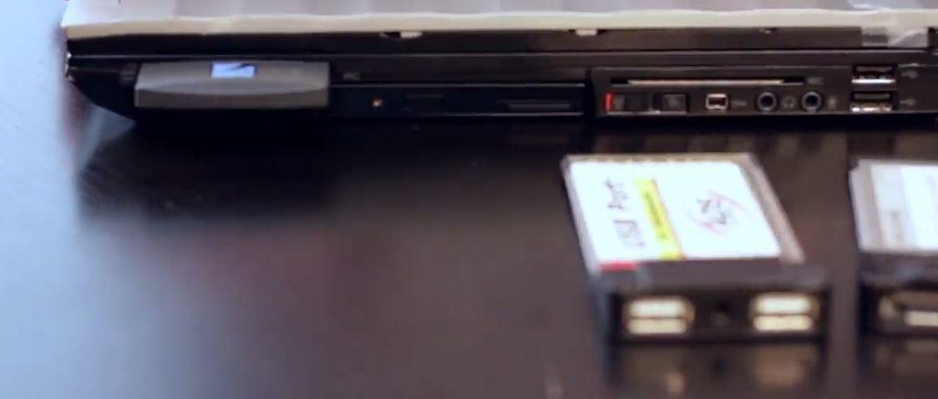
Compare and Contrast Desktop and Laptop Components
PCMCIA Installation

Slide 30
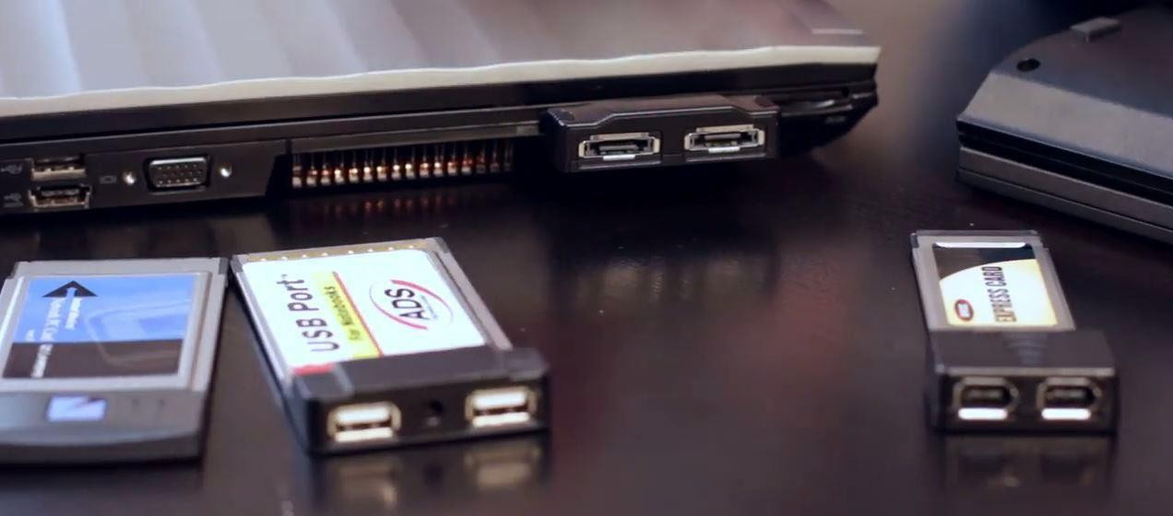
Compare and Contrast Desktop and Laptop Components
Express Card 54mm Installation

Slide 31
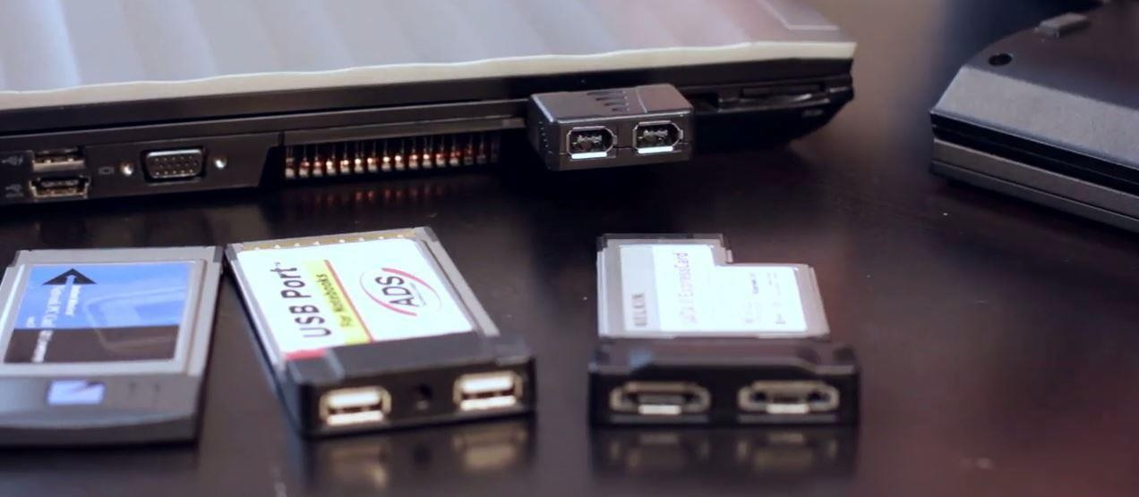
Compare and Contrast Desktop and Laptop Components
Express Card 32mm Installation

Slide 32
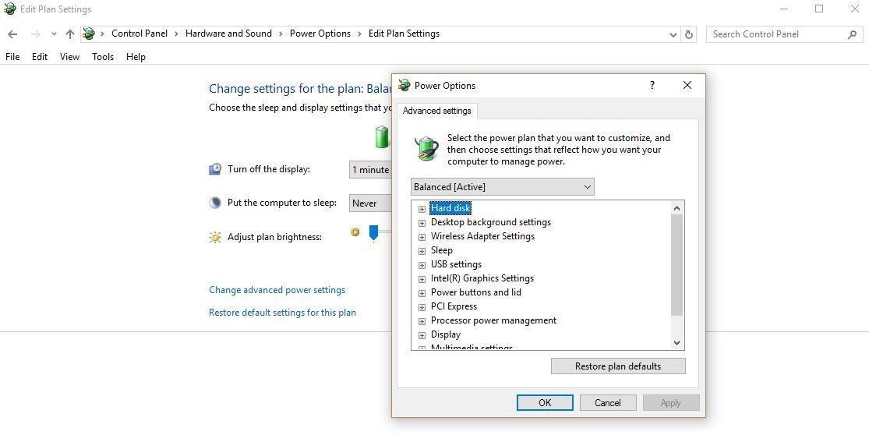
Power Management in Laptops
ACPI (Advanced Configuration and Power Interface) is a new power
management standard which is supported by all modern operating systems.
ACPI ON (but not doing anything)
ACPI Sleep/Standby
ACPI Hibernate
ACPI Hybrid

Slide 33
End of Lecture 9

